Slide 1
ECE 3130 – Digital Electronics and Design
Lab 8
Binary Counter
Fall 2016

Slide 2
Introduction
A binary counter is a device that stores the number of times that an event/process occurs
Up/down counter
When the selector is in the up state, the counter increments its value
When the selector is in the down state, the counter decrements its value

Slide 3
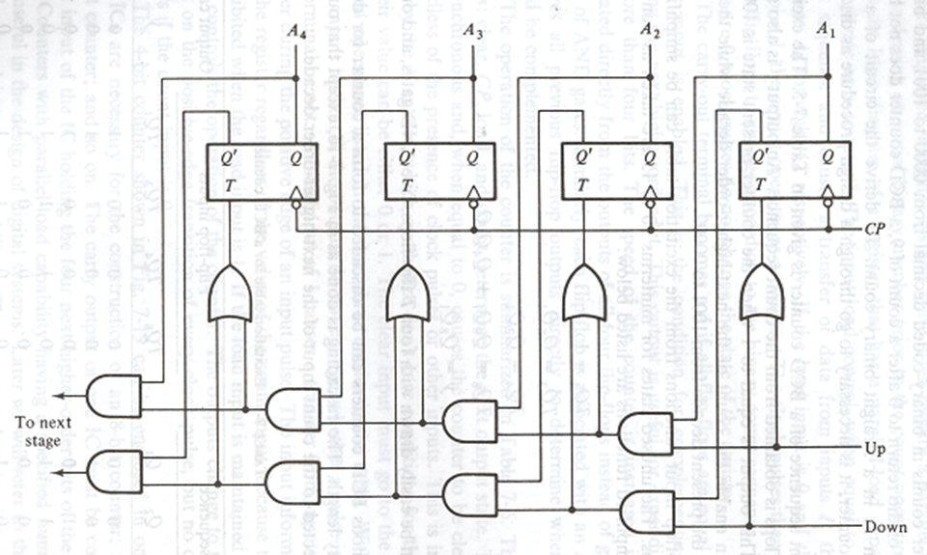
4-bit Up/Down Binary Counter

Slide 4
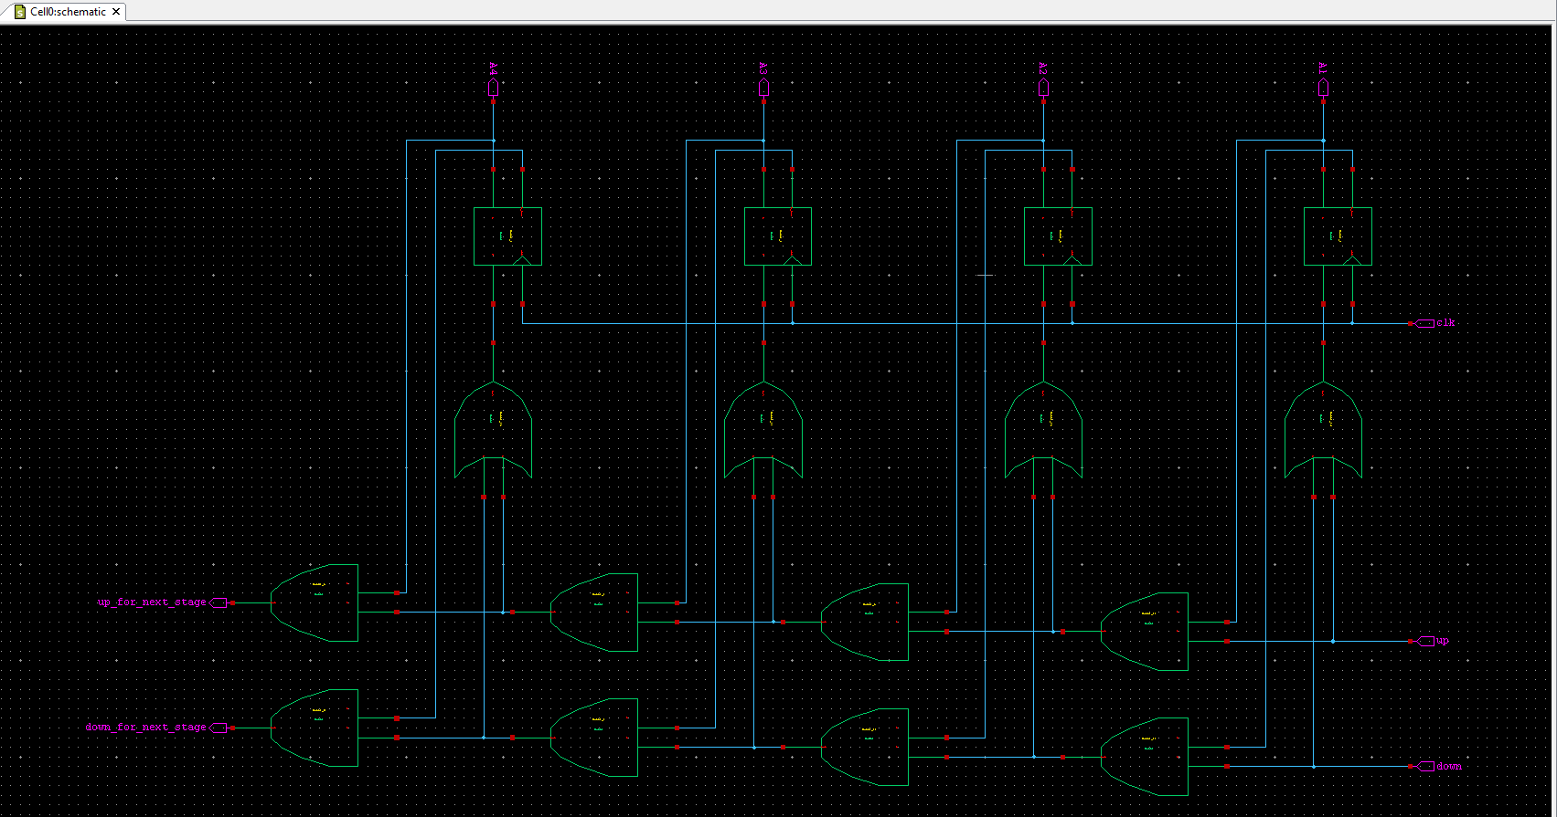
Schematic of Up/Down counter
T Flip-Flop
OR Gate
AND Gate

Slide 5
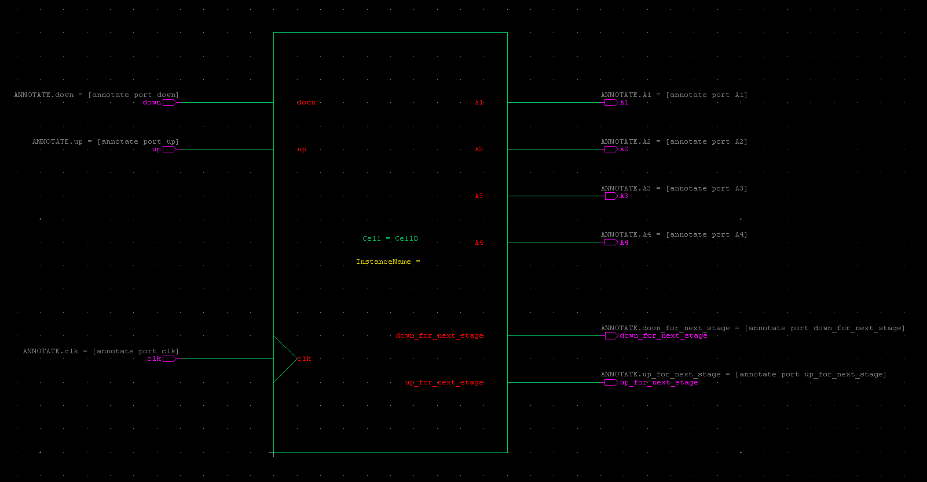
Symbol of Up/Down counter

Slide 6
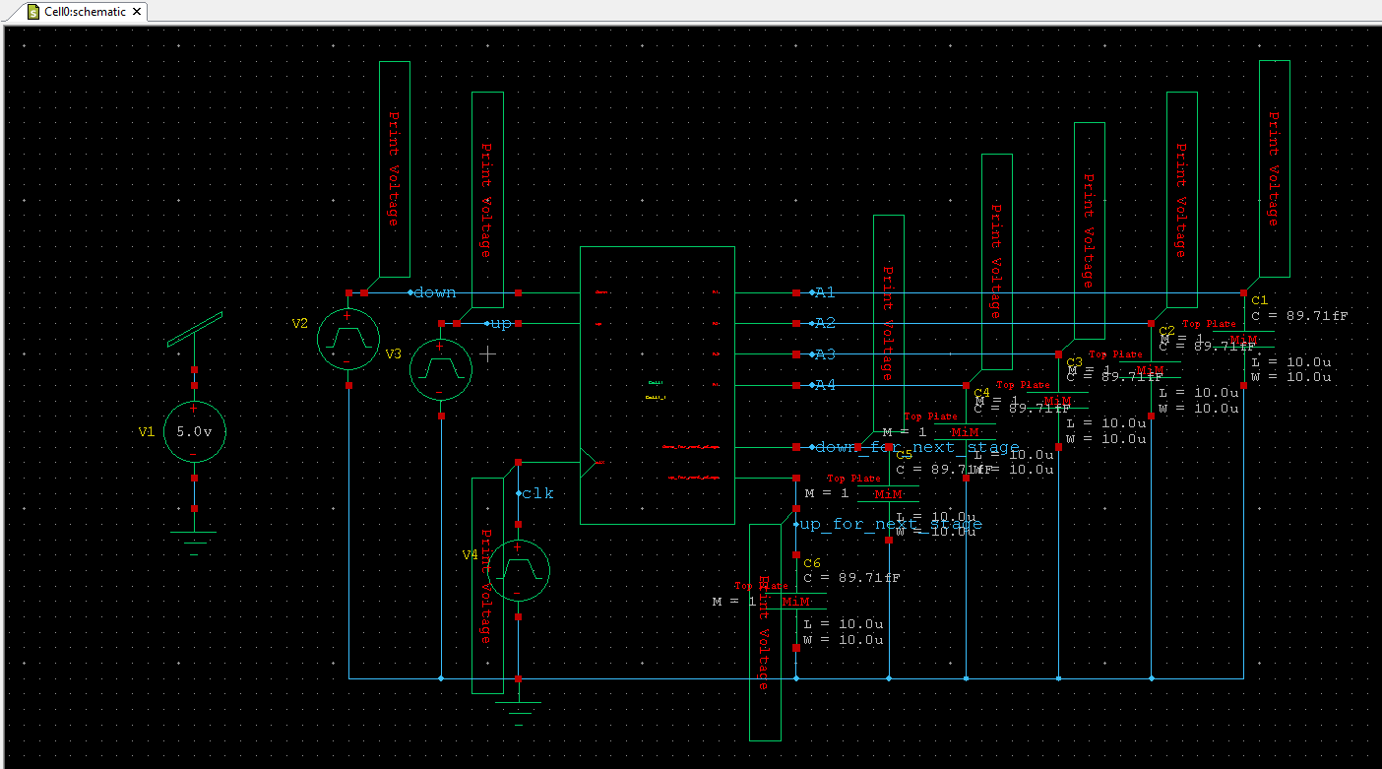
Test circuit of Up/Down counter
clk – period: 20ns, rise/fall time:1ns
up – period: 1500ns
down – period: 1600ns, VLow: 5v, VHigh: 0v
Simulation time: 1500ns, Step time: 5ns

Slide 7
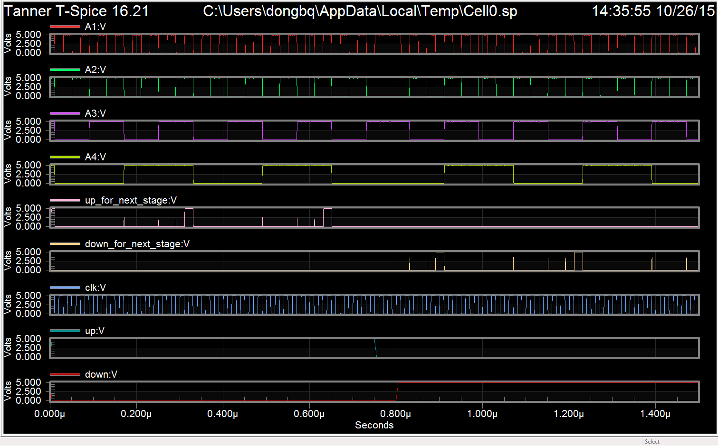
Waveforms of Up/Down counter

Slide 8
Assignment
Build and test a 4-bit up/down binary counter.
Attach all screenshots into one PDF file, including schematic, symbol, test circuit schematic, waveforms.

